Slide 1

CMR Technical Campus Department of CSE
DATA BASE MANAGEMENT SYSTEM PROJECT
TITLE : SPORTS MANAGEMENT SYSTEM
PRESENTED BY:
BATCH-2
B.DEEPTHI-227R1A05D4
G.BHAVYA BHARGAVI-227R1A05E4
B.BALAJI NAYAK-227R1A05D2

Slide 2
ABSTRACT
The Sport management system will provide which manage the activity of many sports at a time. It also manages the selection events for student into collage.
The user will consume less amount of time which compared to manual process through the Sports Managements System this system will take care of all the sports activity in quick manner .
. Nowadays most of the sport management system is having problem like management of the single tournament. To overcome these problems we are proposing the system like sport management system (SMS) with utilities like different tournament automatic or manually match scheduling system will provide utility like notification as a remainder to the player before match. It will avoid duplication of tournament for a player team and game.

Slide 3
INTRODUCTION
The Sports Management System project in DBMS is designed to cater to the needs of sports organizations, clubs, and institutions.
It offers a centralized platform for managing various aspects of sports activities, including player information, match schedules, and performance analysis.
This system will provide real-time updates and notifications to ensure seamless coordination among stakeholders.
The Sport Management System (SMS) is the web based application system which manages the activity of the many sport events at a time. Sport participants are able to register their name and choose the event and also manage the selection activity for student.

Slide 4
Software Requirements
The Sports Management System project in DBMS requires a relational database management system (RDBMS) such as MySQL or Oracle.
Front-end development tools like HTML, CSS, and JavaScript will be utilized for creating the user interface.
Additional software components may include programming languages like PHP or Java for backend functionalities and reporting tools for data analysis.

Slide 5
Hardware Requirements
The hardware requirements for the Sports Management System project in DBMS include a server to host the database and application.
Clients will need devices with internet connectivity to access the system, such as computers, laptops, or mobile devices.
Adequate storage capacity and processing power are essential to ensure smooth performance and data handling.

Slide 6
EXISTING
. Here the existing system is nothing but a manual system in which the admin must fill the members sports club details in an ecel sheet and send it to their supervisor, then the supervisor must merge all the member information details and arrange them in to a single sheet. Maintaining a clean record of all the members is a tedious job in this process.
➔DISADVANTAGES:
Paperback records are hard to maintain.
Searching for a member's information can be gruesome task.
Doesn't provide Security.
Difficulty in updating the records.
T More manual hours is needed to maintain the records.
Updating the member on deadline for payment is difficult

Slide 7
PROPOSAL
Performance Management System is to replace the existing manual system with a software solution. It allows all the employees in different sections of the club to work together and manage a single record.Different areas of the Sports Club can be managed in different tabs by different people.
ADVANTAGES:
Faster processing
Centralized database helps in avoiding conflicts.
Easy to use GUI that does not require specific training.

Slide 8
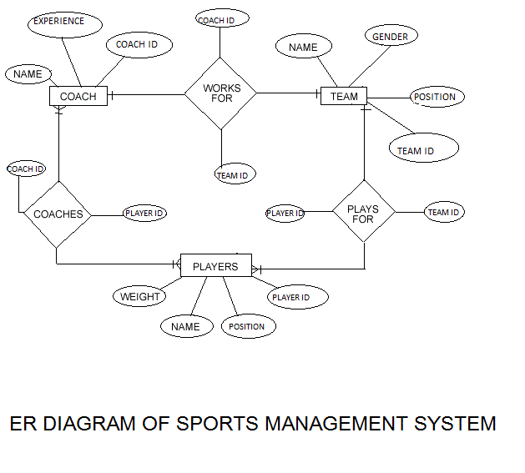

Slide 9
Security Features
The Sports Management System project will incorporate robust security measures, including user authentication, role-based access control, and data encryption.
Regular backups and data recovery procedures will be implemented to prevent data loss and ensure continuity.
Security audits and vulnerability assessments will be conducted periodically to identify and address potential threats.

Slide 10
Conclusion
The Sports Management System project in DBMS offers a comprehensive solution for managing sports activities effectively and efficiently.
By leveraging technology and database management principles, organizations can streamline their sports management processes and improve overall performance.
This system has the potential to enhance collaboration, data accuracy, and decision-making in the realm of sports management.

Slide 11


